Slide 2


Online Food Application
TASTY_FOOD

Slide 3


List of Modules
Admin Module
Customer module
Chat bot
SSO(Single Sign On)
Add Cart
Order History
Order Management
Restaurant Management
Payment Module

Slide 4
Module Description
Main objective of Project:
It ensures prices are accurate and there's less room for error when it's time to settle the bill.
Efficient customer and order management
Makes the ordering process easier

Slide 5
List of Sub Modules
Restaurant
Food and menu
Delivery Details

Slide 6
Food Menu
Definition
Add/update/delete Food item to/form the menu
Update price for a given food item
Update Additional information (description,photo,etc)for a given food item
Show food details and view food price

Slide 7
Delivery Details
Provide a running total cost and details
At order finalization we will request identification information from the customer
Offer a static map of our surrounding area so that customers unfamiliar with our location can find us

Slide 8
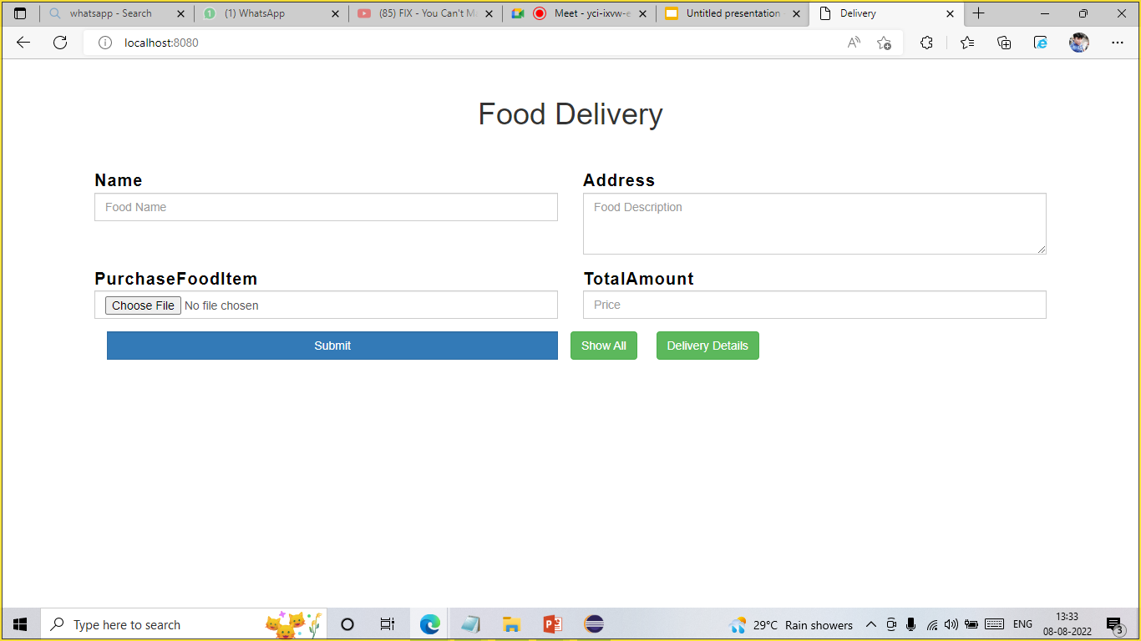
Front End Design
Food application Front end design :
Using HTML, CSS, JS designed a front end page for customer module where it can display all the necessary food items and price and details for contact.

Slide 9
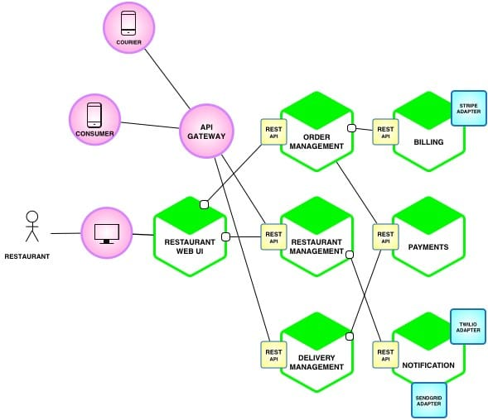
Project Overview
Project Architecture Diagram

Slide 10
Thank You

